Slide 1
Functions & IO
Modified from slides by Dexter again

Slide 2
Table of content
Functions
Applications of function: recursions
Scripting in python
file IO (Input – Output)

Slide 3
Table of content
Functions
Definition
Components of a function
Local and Global variables
Types of arguments
*args and **kwargs
Default argument
Errors
Docstrings
Function annotation
Lambda/ anonymous functions

Slide 4
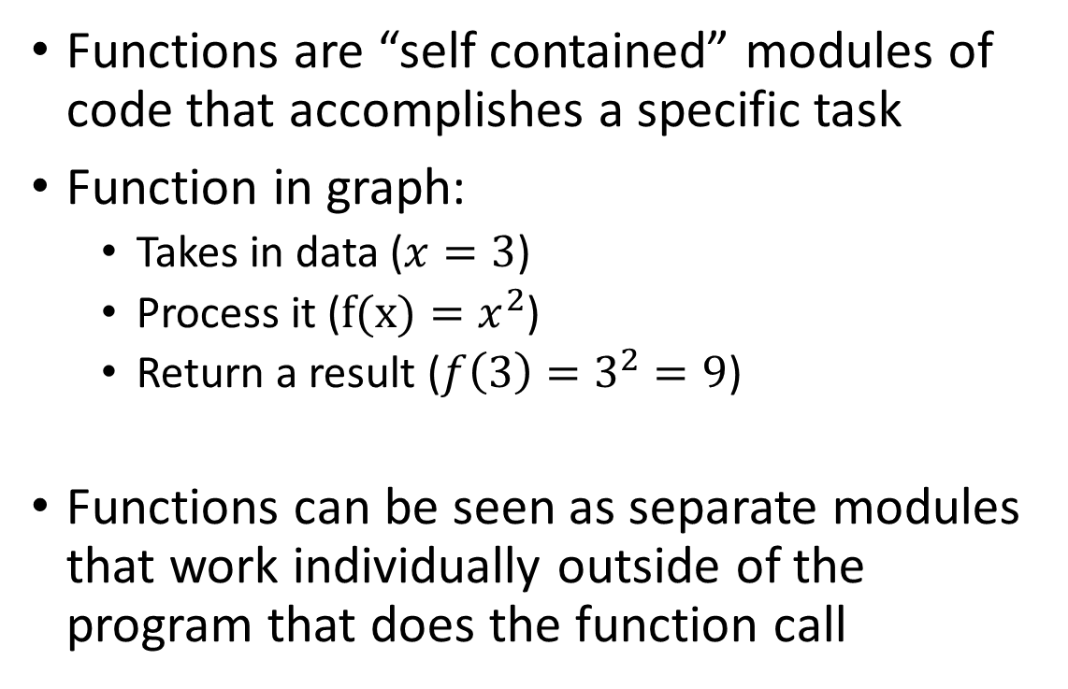
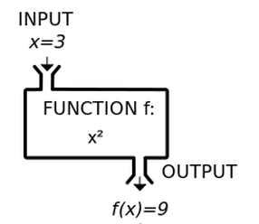
Functions - definition

Slide 5
Functions – why?
Imagine you just built a data processing pipeline that include multiple steps, would you prefer them to be in 500 lines of code, or 10 separate functions?
Or maybe you want to run the same code multiple times, with only minor adjustments to certain variables each time
Readability: Complex programs can be dissected into smaller steps
Reusability:
Functions can be used in different scenarios
Local variables can be reused in different functions

Slide 6
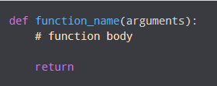
Functions in python
def – Keyword to declare a function
function_name – name of the function
arguments – values passed to the function
Return – return values from a function (Optional)
https://www.programiz.com/python-programming/function

Slide 7
Functions in python – Local and Global variables
Local variables are variables defined inside a function that do not cover scope outside the function
Scope refers to the region that is created:
Global: the entire file can access
Local: only within the function can be variable be accessed
https://www.programiz.com/python-programming/global-local-nonlocal-variables

Slide 8
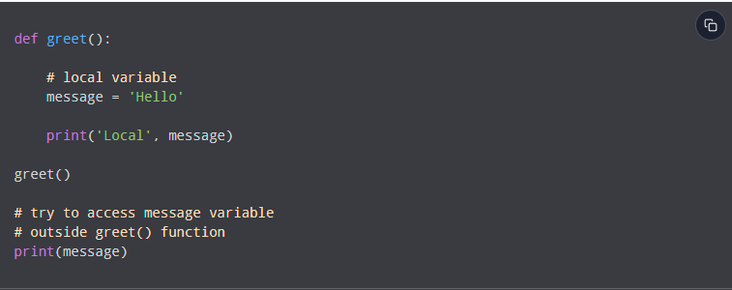
Functions in python – Local and Global variables
Scope refers to the region that is created:
Global: the entire file can access
Local: only within the function can be variable be accessed
https://www.programiz.com/python-programming/global-local-nonlocal-variables

Slide 9
Functions in python – Local and Global variables
Local variables are variables defined inside a function that do not cover scope outside the function
https://www.programiz.com/python-programming/global-local-nonlocal-variables

Slide 10
Functions in python – Local and Global variables
Local variables are variables defined inside a function that do not cover scope outside the function
https://www.programiz.com/python-programming/global-local-nonlocal-variables

Slide 11
Functions in python – Local and Global variables
Local variables are variables defined inside a function that do not cover scope outside the function
https://www.programiz.com/python-programming/global-local-nonlocal-variables

Slide 12
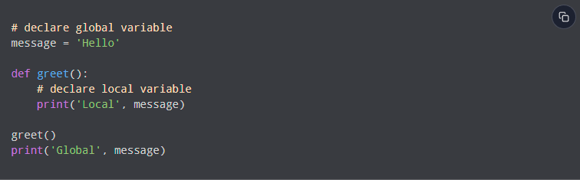
Functions in python – Local and Global variables
Global variables have a global scope
https://www.programiz.com/python-programming/global-local-nonlocal-variables

Slide 13

Functions in python – Local and Global variables
Global variables have a global scope
https://www.programiz.com/python-programming/global-local-nonlocal-variables

Slide 14
Functions in python – Local and Global variables
Global variables have a global scope
https://www.programiz.com/python-programming/global-local-nonlocal-variables

Slide 15
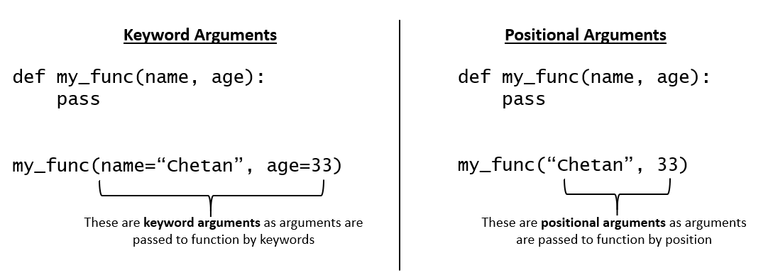
Functions in python – Keyword VS position arguments
Keyword arguments
Names are used to pass the argument in the function call
Order of parameters can change
Position arguments
Arguments are passed in the order of parameters

Slide 16
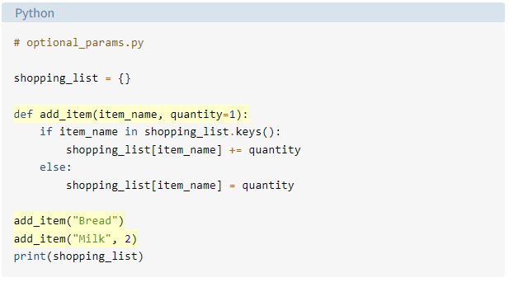
Functions in python – Default arguments
Default arguments: if the function call did not provide a value of the specific variable, then the default value is used
https://realpython.com/python-optional-arguments/

Slide 17
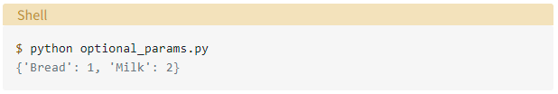
Functions in python – Default arguments
Default arguments: if the function call did not provide a value of the specific variable, then the default value is used
Default values should always come after non-default values
https://realpython.com/python-optional-arguments/

Slide 18
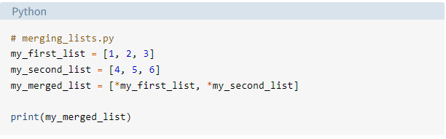
Functions in python – *args and **kwargs
*args and *kwargs allow user to pass multiple arguments (unknown number) to a function
*: unpacking operator
https://realpython.com/python-kwargs-and-args/

Slide 19
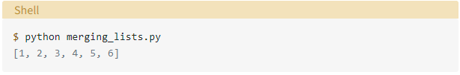
Functions in python – *args and **kwargs
*args and *kwargs allow user to pass multiple arguments (unknown number) to a function
*: unpacking operator
https://realpython.com/python-kwargs-and-args/

Slide 20
Functions in python – *args and **kwargs
*args and *kwargs allow user to pass multiple arguments (unknown number) to a function
*: unpacking operator (for iterables)
**: unpacking operator (for dictionaries)
https://realpython.com/python-kwargs-and-args/

Slide 21
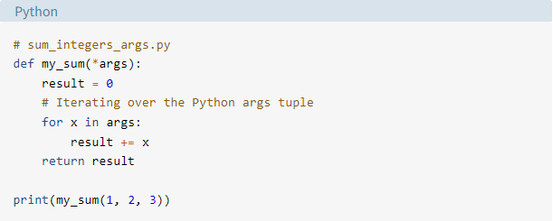
Functions in python – *args and **kwargs
*args and *kwargs allow user to pass multiple arguments (unknown number) to a function
*: unpacking operator
*args: a varying number of position arguments can be used
https://realpython.com/python-kwargs-and-args/

Slide 22
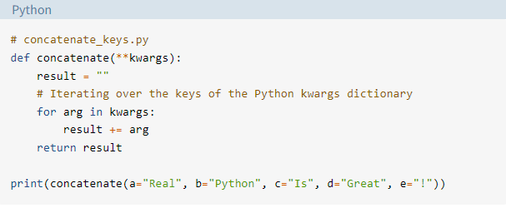
Functions in python – *args and **kwargs
*args and *kwargs allow user to pass multiple arguments (unknown number) to a function
*: unpacking operator
*args: a varying number of position arguments can be used
**kwargs: similar to *args, but accept keyword arguments
https://realpython.com/python-kwargs-and-args/

Slide 23
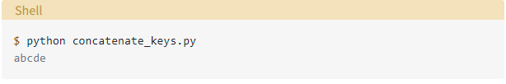
Functions in python – *args and **kwargs
*args and *kwargs allow user to pass multiple arguments (unknown number) to a function
*: unpacking operator
*args: a varying number of position arguments can be used
**kwargs: like *args, but accept keyword arguments
https://realpython.com/python-kwargs-and-args/

Slide 24
Functions in python – Errors
Is there going to be an error?
https://realpython.com/python-optional-arguments/#error-messages-related-to-input-arguments

Slide 25
Functions in python – Errors
SyntaxError: non-default argument follows default argument
Fix: parameters with no default should always come before default value
https://realpython.com/python-optional-arguments/#error-messages-related-to-input-arguments

Slide 26
Functions in python – Errors
SyntaxError: non-default argument follows default argument
Fix: parameters with no default should always come before default value
TypeError: function missing () required positional arguments: ‘argument_name’
Fix: Required positional arguments
https://realpython.com/python-optional-arguments/#error-messages-related-to-input-arguments

Slide 27
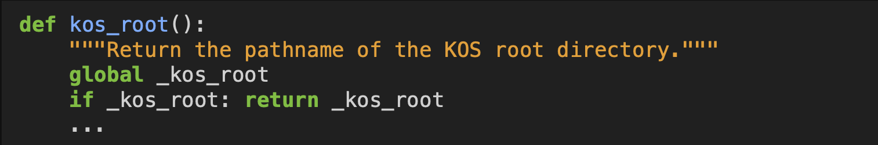
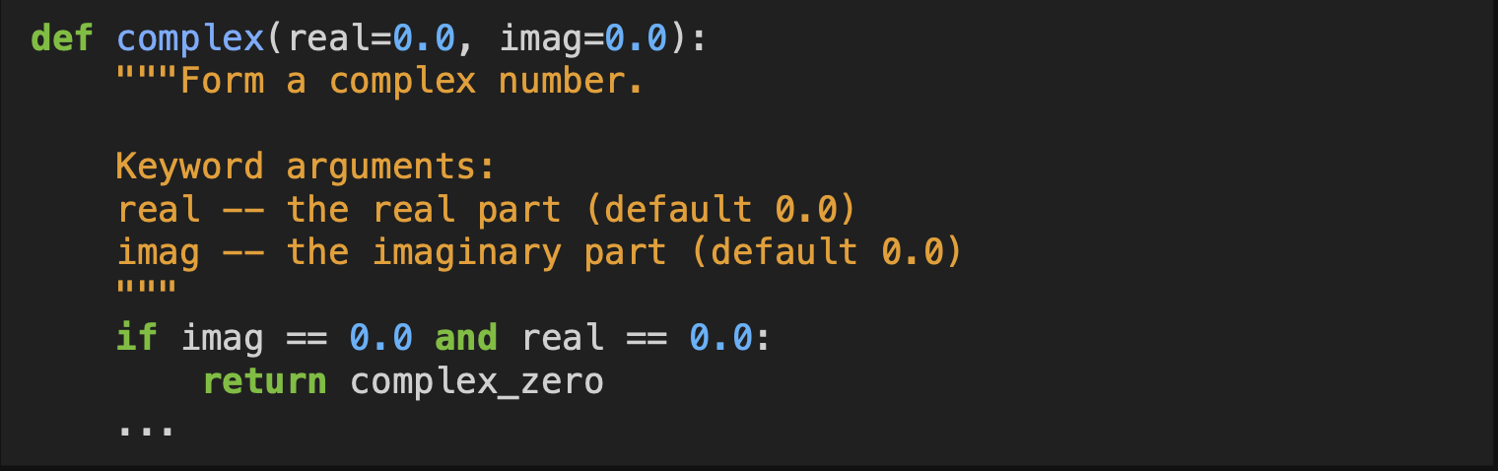
Functions in python – Docstrings
Docstrings are basically documentations for functions
Main goal is to increase readability and reusability
One-line docstrings
Provides the main use of function
Multi-line docstrings
Provides main use
Provides description of arguments
Default values
https://peps.python.org/pep-0257/

Slide 28
Functions in python - Annotate
Function annotations are a better way to restrict data types of arguments and outputs
Syntax:
def foobar(arg: type, arg: type = default) -> type
e.g. Assume you want to develop a function to multiply two integers
def multiply(a: int, b: int) -> int
Default argument values with types:
def multiply(a: int = 1, b: int = 2) -> int

Slide 29
Lambda functions
Lambda functions are ”anonymous” functions
Function without a name
Similar to list comprehension concept, one-liner of normal functions
Syntax: lambda arg: expression
e.g. (Multiplying two numbers together)
c = lambda a, b: a * b
c(1, 2) = 2
Very useful for functional programming (map function)

Slide 30
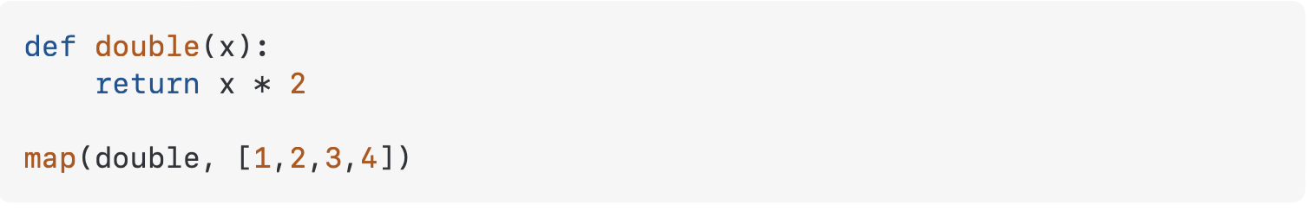
Lambda functions – why bother?
Map(fun, iter)
fun: function, iter: iterable (e.g. list, tuple)
Mapping the function to every item of the iterable
Which function is more readable below?

Slide 31
Organizing functions into modules
Modules are considered as code libraries consisting of custom functions your wrote for your projects
preproc.py (preprocessing) for all preprocessing functions, util.py (utilities) for utility functions, and plot.py for plotting functions
To have all the functions in a new code environment, use the syntax
import preproc, plot, util
from preproc import interpolate_linear (importing specific functions)
This is the exactly the function of packages (discussing tomorrow)

Slide 32
Organizing functions into modules
Modules are considered as code libraries consisting of custom functions your wrote for your projects
This is the exactly the function of packages (discussing tomorrow)
However the python modules need to be in the same directory as the code file you are saving
Or use the sys module and add the system path into the file
e.g. sys.path.append()

Slide 33
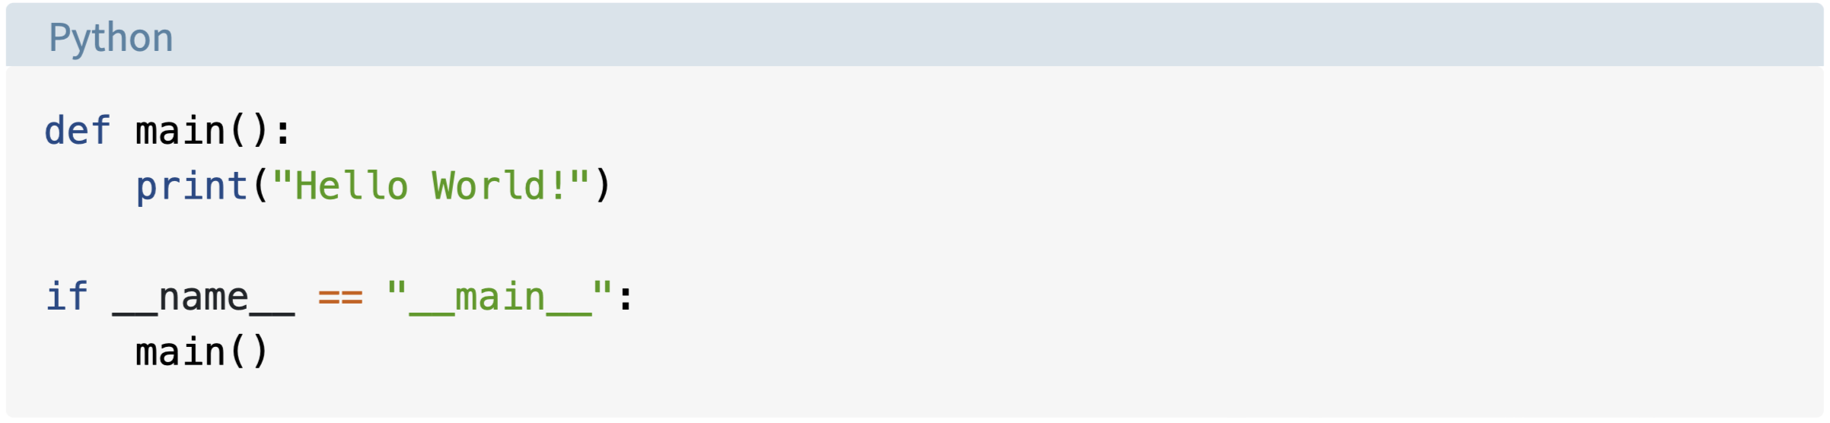
Discriminating between scripts and modules
Even though we have been using interactive tools to code with python, the most efficient way of running python code is still accessing through the terminal: python your_code.py
Common best practices: Using main() function to wrap up the script code

Slide 34
Discriminating between scripts and modules
__name__ = “__main__” determines the execution context
Only true if python is executing the script not importing it
Common best practices:
Put most code in functions
Use __name__ to control execution of code
Use the main() function to wrap up all the functions you want to run sequentially as a script

Slide 35
Interacting with files with IO
So far we learn about how Python works on it own
But how does python uses information from other files and process accordingly?
File Input Output (IO) is an important part when constructing programming languages

Slide 36
Interacting with files with IO
So far we learn about how Python works on it own
But how does python uses information from other files and process accordingly?
File Input Output (IO) is an important part when constructing programming languages
What are the most common files you encounter?

Slide 37
Interacting with files with IO
So far we learn about how Python works on it own
But how does python uses information from other files and process accordingly?
File Input Output (IO) is an important part when constructing programming languages
What are the most common files you encounter?
.csv, .txt, .h5, .png, .avi, .tif,

Slide 38
Interacting with files with IO
So far we learn about how Python works on it own
But how does python uses information from other files and process accordingly?
File Input Output (IO) is an important part when constructing programming languages
What are the most common files you encounter?
.csv, .txt, .png, jpg, .mp3, .wav, .avi, .tif, .abf
.mat, .npy

Slide 39
Interacting with files with IO
So far we learn about how Python works on it own
But how does python uses information from other files and process accordingly?
File Input Output (IO) is an important part when constructing programming languages
What are the most common files extensions you encounter?
(.csv, .txt), (.png, jpg), (.mp3, .wav, .avi), .mp4, .tif, .abf, .slp
.mat, .npy
.h5, .mmap

Slide 40
Interacting with files with IO
Different extensions have different ways to opening it
In Python, different data streams (Photos, Videos, Audios) have a corresponding package with it
Today’s session focuses on native python interaction with files

Slide 41
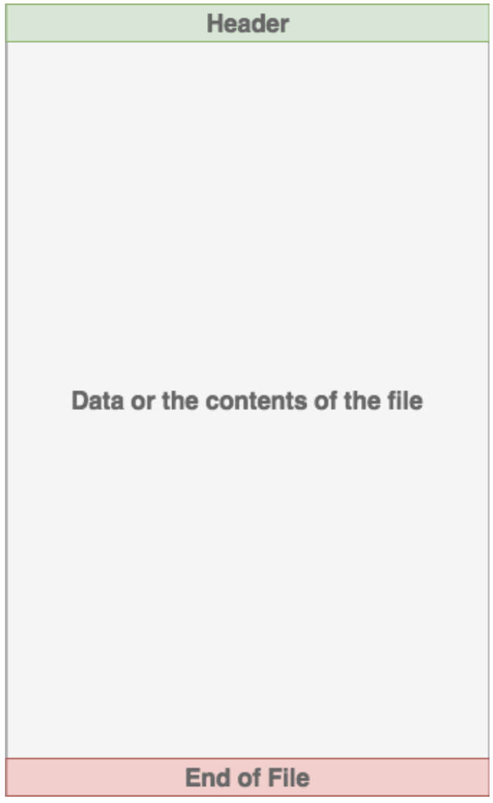
Structure of files
Header: metadata describing name, size, type
Content: actual file data
End of File (eof): Character indicating end of file

Slide 42
Opening and Closing files in Python
There are two basic functions: open(’path’, read-mode) and close(‘path’)
Path can be absolute/ relative path
Open can be in two modes: read (‘r’) and write (‘w’)
Keeping file open can be dangerous:
Your operating system limits number of opening files
File kept open have the risk of data leakage
That is why open often is used with with
the keyword with is a context manager that will automatically close the file when finish

Slide 43
Syntax for files handling
with open(’important_info.txt’, ‘r’) as f:
# Do more file processing here
with serves as a context manager
Now you will access f to read in data from the file

Slide 44
Reading files
There are three functions that can read files in different size
read(size): reading size number of bytes, read all the file if no restraint is put
readline(): reading the entire line (stop at newline)
readlines(): reading all lines
Line break in text files: \n (linux) \r\n (windows) \r (mac)

Slide 45
Reading files
There are three functions that can read files in different size
read(size), readline(), readlines()
Example syntax:
with open(’important_info.txt’, ‘r’) as f:
lines = f.readlines()
Save all text into lines variable

Slide 46
Reading files
There are three functions that can read files in different size
read(size), readline(), readlines()
Example syntax:
with open(’important_info.txt’, ‘r’) as f:
for line in f:
print(line)
Directly iterating through the file object and reading each line

Slide 47
Writing files
Writing files has two similar functions as reading:
write(string): wring a string object to the file
writelines(seq): write a sequence of strings to the file
Syntax:
with open(’important_info.txt’, ‘w’) as f:
f.write(‘PNI’)

Slide 48
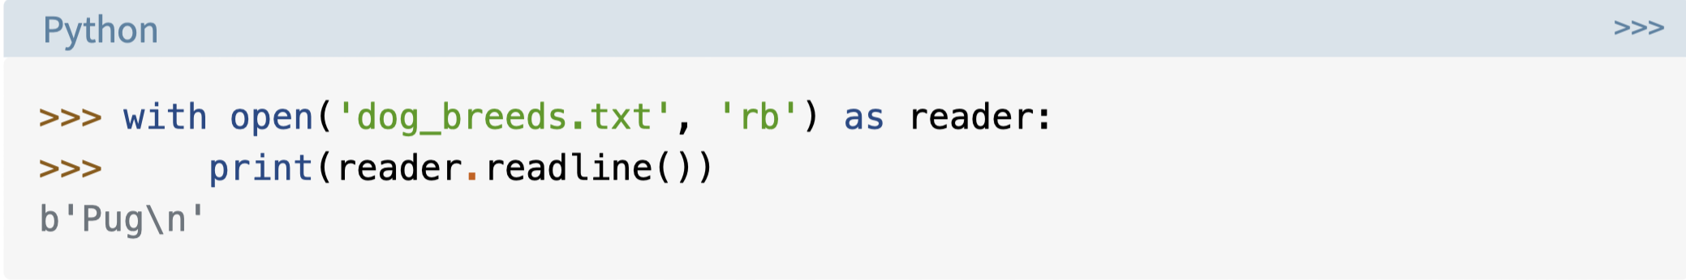
Binary files
Sometimes files are in binary format, therefore apart from read and write mode, there are also readbinary (‘rb’) and writebinary (‘wb’)
Read out content with have a character b in front
In order to convert to string format; use decode()
Example: random_str.decode()

Slide 49
References and readings
https://realpython.com/read-write-files-python/
https://realpython.com/why-close-file-python/
https://realpython.com/python-main-function/

